Slide 1
Artificial Intelligence
Ms Sastre

Slide 2

What is Intelligence?
Pair off into groups and pick 3 things that comes to your mind when you think of intelligence

Slide 3

Linguistic Intelligence
Ability to speak, recognize and use mechanisms of phonetics.
Reading, writing & telling stories.
Think of how important communication is for humans.
Imagine a robot with perfect linguistic intelligence.

Slide 4

Musical Intelligence
Ability to understand the meaning of sound, pitch, meaning made from rhythm.
Music and emotions often have an effective connection.
Would a robot be able to make good music?

Slide 5
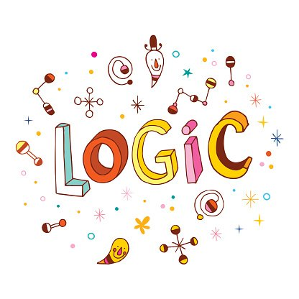
Logical-Mathematical Intelligence
Understanding complex and abstract ideas.
Sequential logic skills.
Inductive and Deductive thinking patterns.

Slide 6

Spatial Intelligence
The ability to visualize or view spatial information.
Image manipulation, graphic and art skills.
Interior designers show great spatial intelligence.

Slide 7
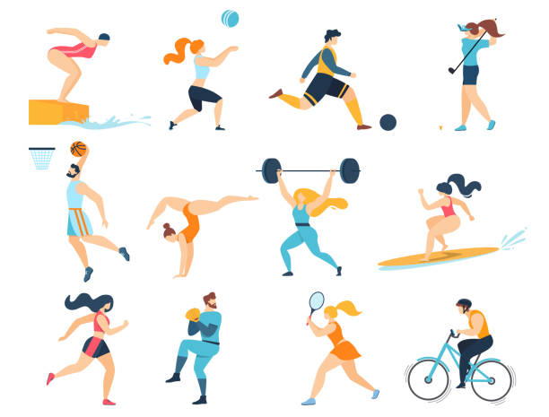
Bodily-Kinesthetic Intelligence
Ability to handle tools or perform physical exercises with the body.
Also involves a sense of timing and the perfection of skills through mind-body union
Athletes, dancers & surgeons.

Slide 8

Intra-Personal Intelligence
Ability to differentiate between one's own emotions, intentions and motivations.
Clear in psychological, spiritual leaders and philosophers.

Slide 9

Interpersonal Intelligence
Ability to interpret the mental state (Feelings, motivations) of others.
Teachers, social workers, actors and polititions perform all interpersonal knowledge.

Slide 10

Naturalistic Intelligence
Ability to identify, classify and manipulate elements in the environment.
It means you tend to learn by connecting your understanding with the world around you.
This can be exploited with marketing.

Slide 11
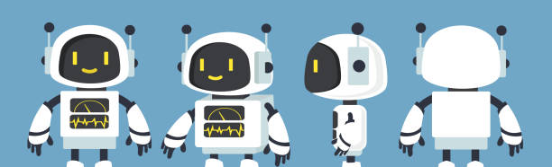
Build a Bot!
Your assignment is to build a robot.
You may only pick 3 out of the 8 types of intelligence.
Create a word document with your robot and save it to teams.
Explain what your robots name and function is. Also explain your reasons for picking the types of intelligence.

